Slide 1
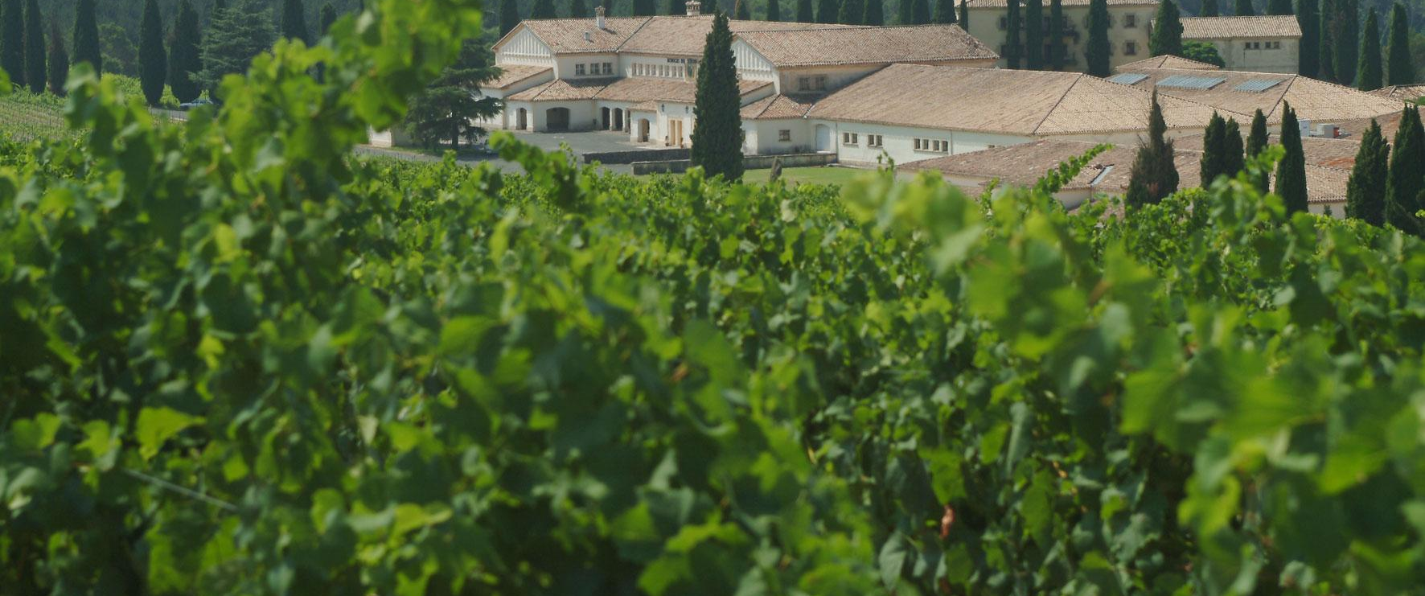
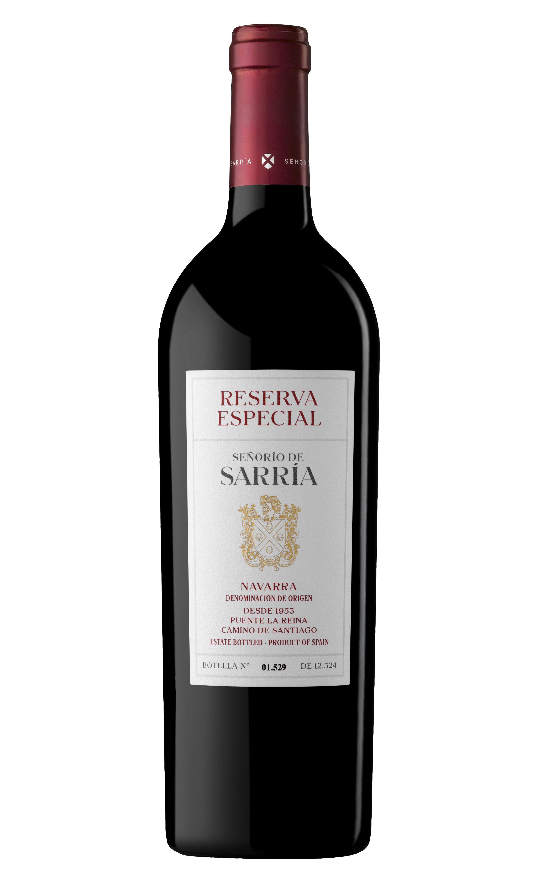
SEÑORÍO DE SARRÍA RESERVA ESPECIAL
D.O. NAVARRA
Tasting notes Colour: A deep, black cherry colour.
Nose: Intense aromas of ripe black fruit, cocoa and vanilla against a balsamic and spicy backdrop that finish with subtle notes of chocolate-mint. Complex with well integrated aromas.
Palate: Powerful, elegant and well structured. Unctuous with a smooth entry of black fruit and vanilla. Good finish with spicy and balsamic notes.
Serving recommendations
Food pairing: Grilled red meat, game dishes (both large game and small bird game).
Serve at 16C to 18°C.
Contains sulphites.
Awards
92 puntos James Suckling 2022
Medalla de Bronce Decanter 2021
Previous Vintages Awards
91 points Guía Peñón 2021
Gold medal Mundus Vini 2020
Gold medal Mundus Vini 2019
Silver medal Decanter World Wine Awards 2019
Gold medal Challenge International du Vin 2018

Slide 2
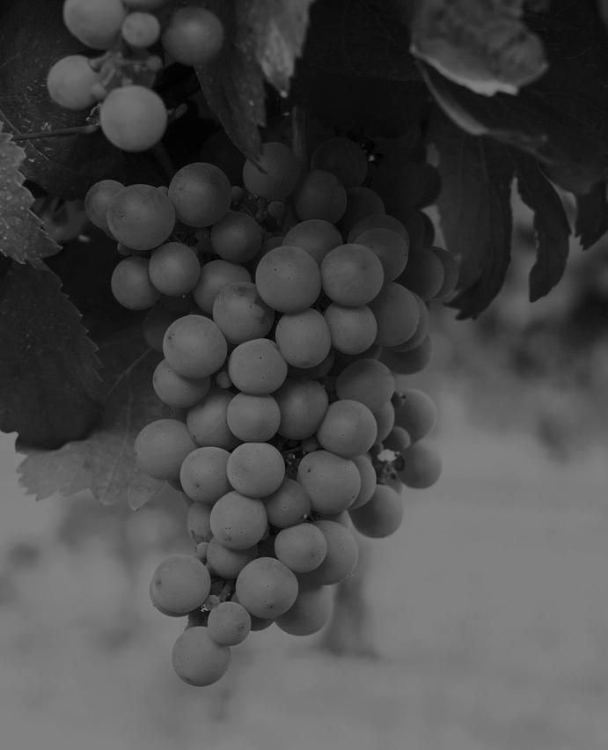
SEÑORÍO DE SARRÍA RESERVA ESPECIAL
D.O. NAVARRA
Technical data
Appellation: NAVARRA
Grape varieties: Cabernet Sauvignon and Graciano
Vintage: 2017
Production area: Puente la Reina, Navarra.
VINEYARD (OWN PROPERTY)
Surface area of owned vineyard: 100 ha (247 acres)
Sites: Puente la Reina, Olite and Corella (Navarra)
Soil-type: Brown limestone and loam
Average age of the vines: 30 years
Density of plantation: 3,000 vines/ha
Yield: 4,000 kg/ha
Growing system: Trellised and bush vines
VINIFICATION
Harvesting: By hand
Date of harvest: September - October
Fermentation: In temperature-controlled stainless steel vats
Temperature of fermentation: 28°C
Duration of fermentation: 15 days
Ageing time in barrel: 24 months
Type of barrels: French and American (1 and 2 years old)
Time aged in bottle: 1 year minimum
Analysis data
Alcoholic degree: 14,5 %
Logistics data
Bottle: Bordeaux old-style 75cl.
Closure: Natural cork
Case: 6 bottles
Case measurements: 25 x 31 x 17cm
Case weight: 7.5 kg
Palletisation: Euro pallet 80 x 120: 504 bottles
Number of cases per layer: 21
Number of layers: 4
Number of cases per pallet: 84
EAN code bottle: 8411558009995
EAN code case: 78411558000458
Bodega de Sarría. Señorío de Sarría, sn. 31100 Puente la Reina (Navarra) T +34 948 202 200
www.bodegadesarria.com // info@bornosbodegas.com

